Slide 1
Smart Study Skills
Dr. Steven Raaijmakers
Educational consultant and trainer

Slide 2

How to study?

Slide 3
How to study?
Tips on the internet:
Keep a regular schedule (like you’re going to class)
Use a dedicated spot to study
Study in short boosts rather than long hauls
Take breaks
Ask for help when you need it
Skillslab
https://students.uu.nl/en/student-life/workshops-skills-lab
skillslab@uu.nl

Slide 4
Programme of today
Aim: to provide tools to study effectively & efficiently
Topics:
Learning objectives
Effective learning techniques
Active learning
Wrap-up

Slide 5
Studying at Utrecht University
What does the UU expect from students?
To study actively
To show engagement and commitment
To think critically
How does the educational model of the UU affect your study approach?

Slide 6
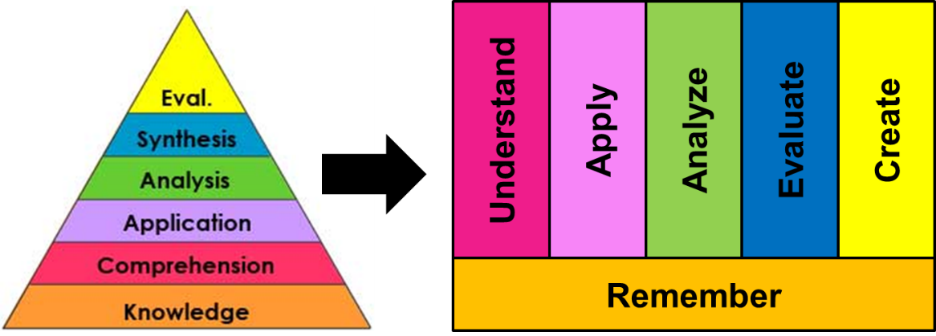
Learning objectives
Learning objectives indicate:
main points of the content of the course
What will be assessed and in what way
Learning objectives within Utrecht University are based
on Bloom’s Levels of learning:

Slide 7
Learning objectives
Remember: Recognizing and recalling facts
Describe, memorize, define, identify, name, locate
Understand: Making sense out of information in your own words
Interpret, summarize, explain, infer, paraphrase
Apply: Use information in a new (but similar) situation
Use, make, draw, apply, solve, calculate
Analyze: Take information apart and explore relationships
Categorize, examine, compare, organize, contrast

Slide 8

Learning objectives
Finding the right fit
Learning objective
Learning
activity

Slide 9
Effective learning
What do I need to study?
How do I know when I am done?
How am I going to study?

Slide 10
Effective learning techniques

Slide 11
Effective learning techniques
Highlighting
Rereading
Summarization
Practice testing
Distributed practice
How many of you use these techniques?
How effective do you think these techniques are?

Slide 12

Highlighting
Not very effective
Difficult when you are not able to pick out key points in the text
Risk of losing the main thread

Slide 13
Rereading
Not very effective
There is nothing new to learn the second time
Risk of metacognitive illusion: illusion of knowing
Recognizing is not the same as knowing!

Slide 14
Summarization
Could be effective, but not always efficient
Requires skill in summarizing
If you do this, you should summarize in your own words, don’t reproduce
Creating beautiful summaries feels very active (behaviourally active vs cognitively active)

Slide 15
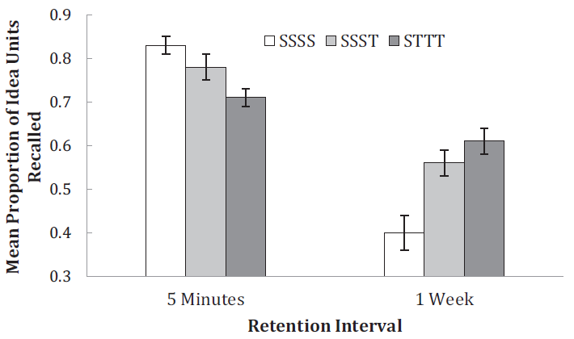
Practice testing
(Very) effective
Come up with test questions and answer them
Use old test questions to test yourself
Do this as a group and exchange test questions
Use the metacognitive benefits! Use the feedback!

Slide 16
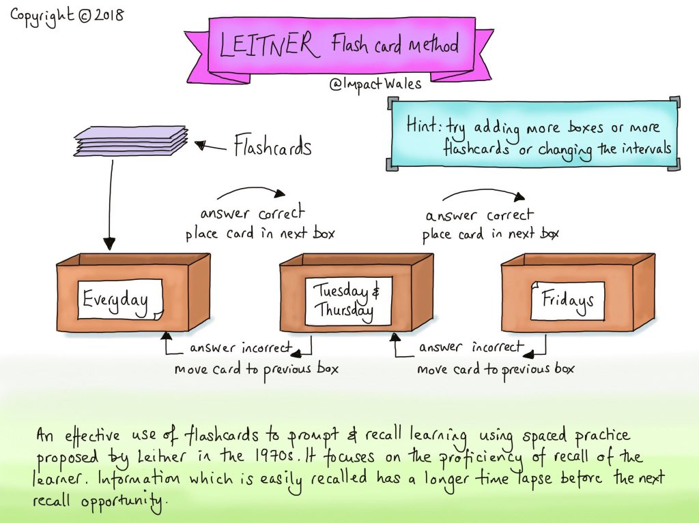

Slide 17
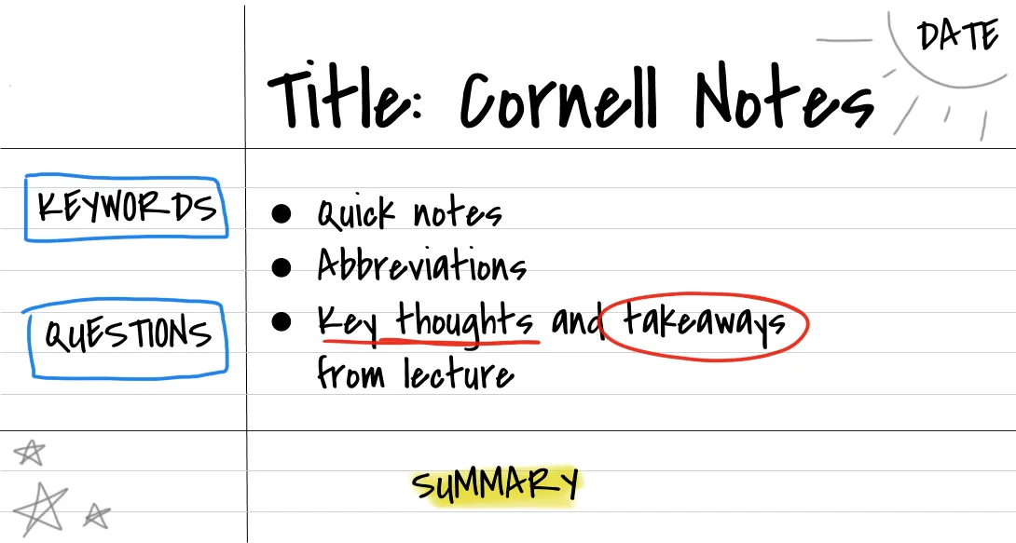
Practice testing

Slide 18
Practice testing
Testing = learning
Metacognitive benefit
(be honest during testing)

Slide 19
Spaced practice (or study)
Very effective
Avoid cramming!

Slide 20
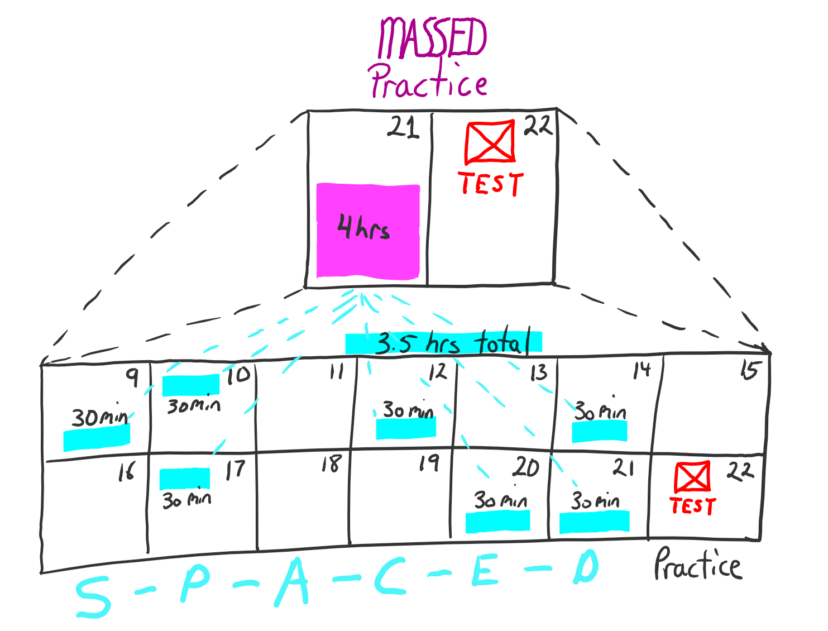

Slide 21
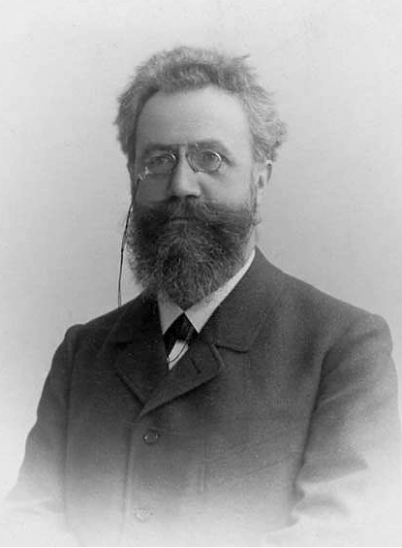
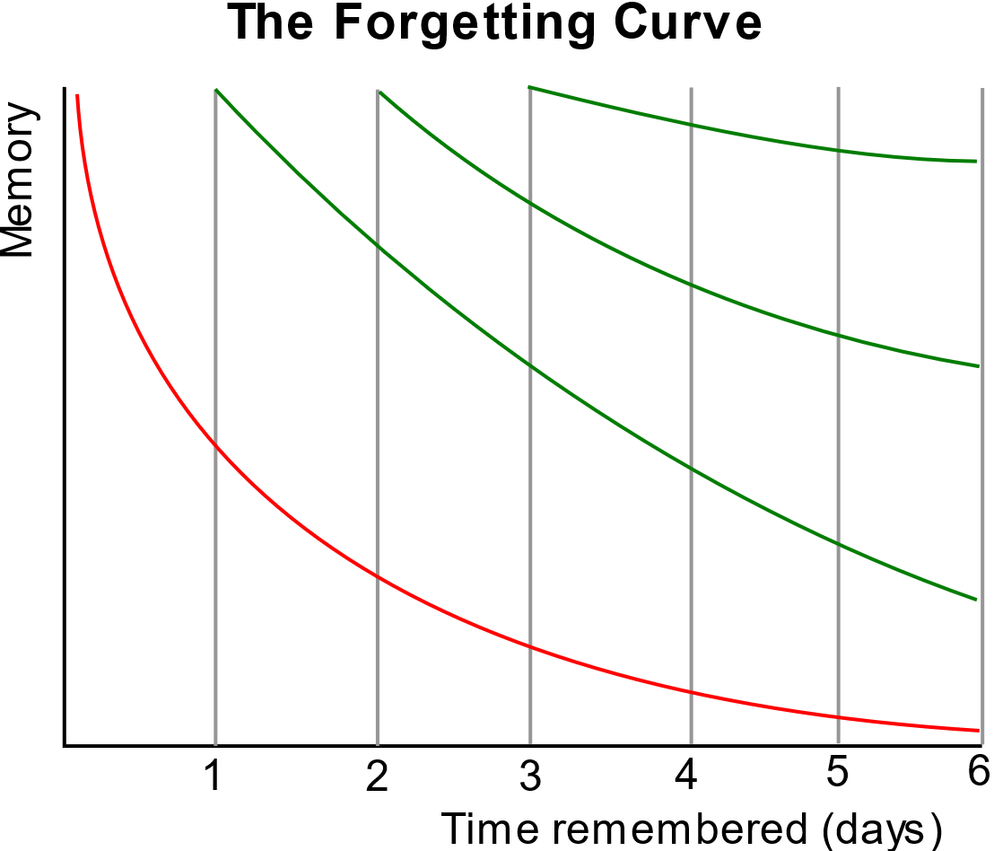
Spaced practice
Learning (or memory) has been studied extensively from about 1885.

Slide 22
Spaced practice
+
Practice testing
=
Spaced retrieval practice

Slide 23
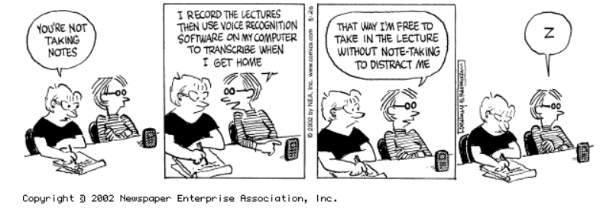
Active learning?

Slide 24
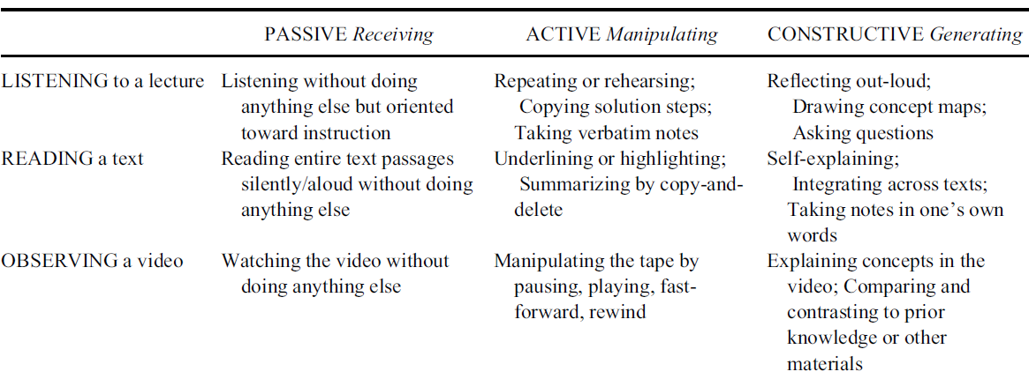
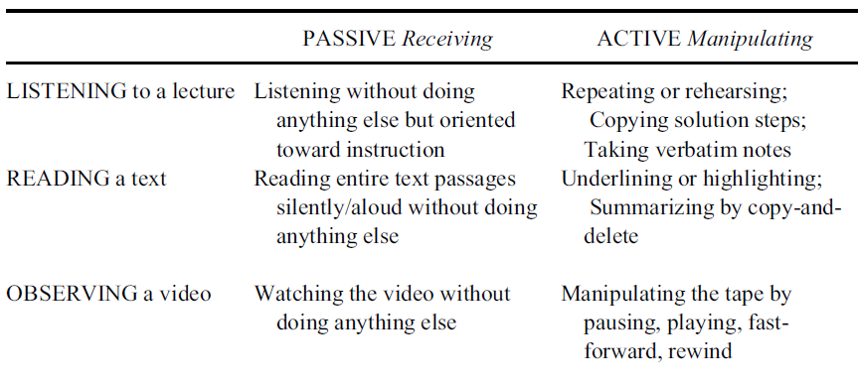
Active (and constructive) learning!
More cognitively active (engaged)

Slide 25
Wrap-up
Use the learning objectives
Space your learning!
Test yourself (practice)!

Slide 26
“Learning is deeper and more durable when it’s effortful. Learning that’s easy is like writing in sand, here today and gone tomorrow”
(from: Make it Stick – The Science of Successful Learning)

Slide 27
Using learning objectives optimally
SMART formulation of learning objectives
Keep overview of all learning objectives
Planning smart learning objectives: clear end goals.

Slide 28
Using learning objectives optimally
Keeping complete overview and track of learning objectives is key!

Slide 29
Using learning objectives optimally
Do not waste time in things you already know
But be aware of metacognitive illusions.
The test information is only useful if it is accurate

